Slide 1

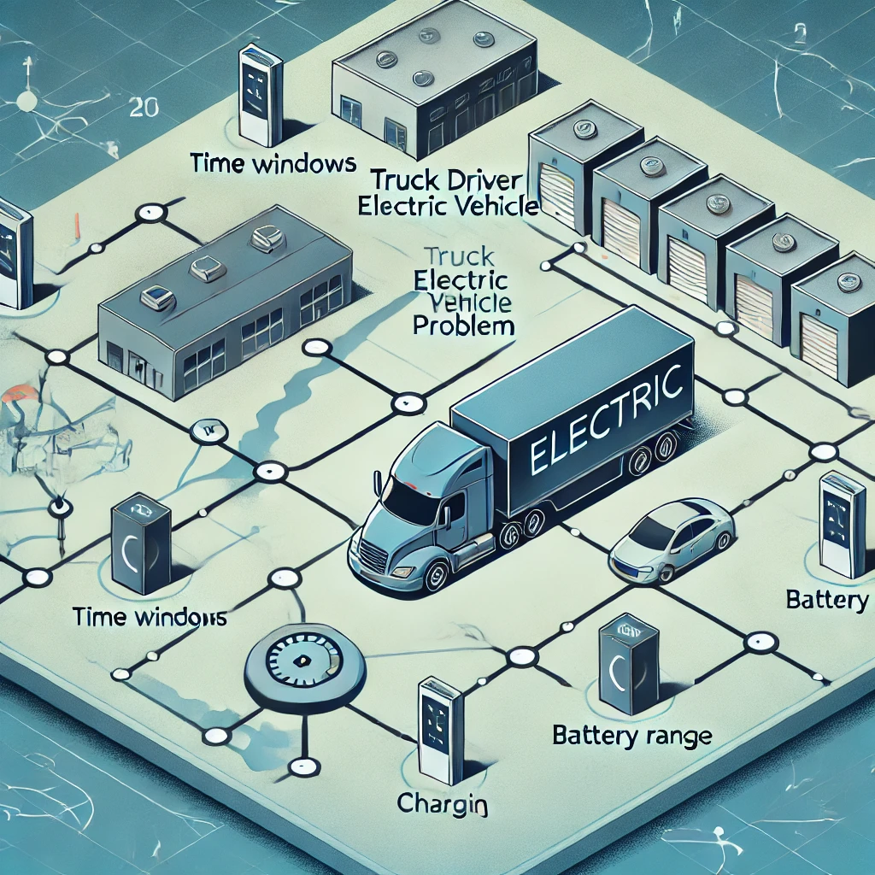
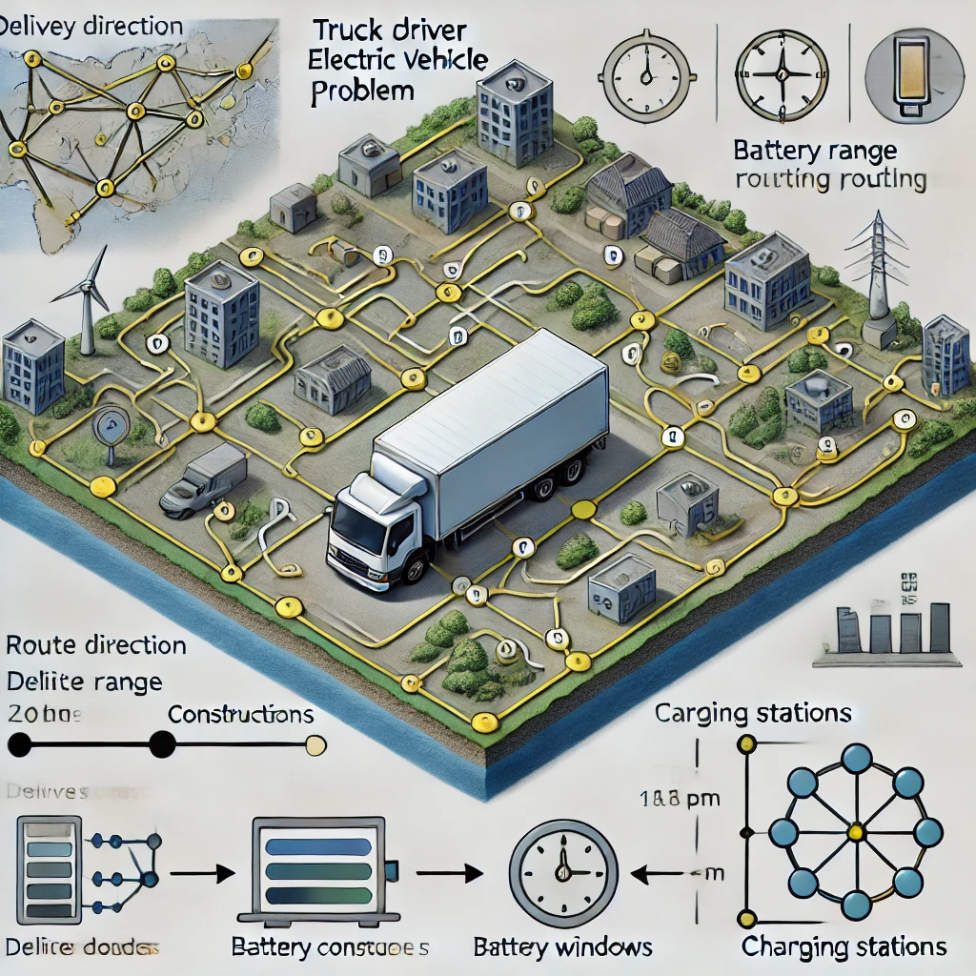

Electric Vehicle Truck Driver Scheduling Problem

Slide 2
fit
s
v
n
d
r
b
m
s
v
dull
Virtual Graph

Slide 3
fit
fit
s
v
s
v
n
d
r
b
m
d
r
b
n
m
s
v
s
v
dull
dull
fit
fit
s
v
s
v
n
d
r
b
m
d
r
b
n
m
s
v
s
v
dull
dull

Slide 4
Possible transition path on virtual graph from n to m:
fit
Alternative A:
without having break/rest
s
v
n
d
r
b
m
s
v
fit
dull
s
v
n
d
r
b
m
s
v
dull

Slide 5
Possible transition path on virtual graph from n to m:
fit
Alternative B:
Having break/rest after driving between n and m
s
v
n
d
r
b
m
s
v
dull
fit
s
v
n
d
r
b
m
s
v
dull

Slide 6
Possible transition path on virtual graph from n to m:
fit
Alternative C:
First having break/rest then driving between n and m
s
v
n
d
r
b
m
s
v
dull
fit
s
v
n
d
r
b
m
s
v
dull

Slide 7
New setting:
Passing CS without charging
fit
fit
s
v
s
v
n
d
r
b
CS
d
r
b
m
s
v
s
v
dull
dull
We should be able to have all three possible alternatives for transition between CS and m if we passing by the cs by connecting dull/fit before charging station to dull/fit after charging station.
What would be the condition to be able to traverse the passing by link?
Whenever the condition for visit is satisfied the condition for passing by is also satisfied because we have to be sure that the distance between n and Cs must be traversed and then it can travel the distance between CS and m without charging at CS.
By which REF? REF is added that only adds the distance (time) between CS to m and works as Start from CS towards m.

Slide 8
We are in dull/fit and able to visit:
fit
fit
s
v
s
v
n
d
r
b
CS
d
r
b
m
s
v
s
v
dull
dull
First alternative for passing CS is connecting fit before CS to fit after CS which means we are in “fit” after CS and there will be two options for traveling the virtual graph between CS and m:
Driving → visit (red path)

Slide 9
We are in dull/fit and able to visit:
fit
fit
s
v
s
v
n
d
r
b
CS
d
r
b
m
s
v
s
v
dull
dull
First alternative for passing CS is connecting fit before CS to fit after CS which means we are in “fit” after CS and there will be two options for traveling the virtual graph between CS and m:
2. Driving → break/rest → visit (the purple path)

Slide 10
We are in dull/fit and able to visit:
fit
fit
s
v
s
v
n
d
r
b
CS
d
r
b
m
s
v
s
v
dull
dull
Second alternative for passing CS is connecting dull before CS to dull after CS (by same REF ) which means we are in “dull” after CS and there will be one options for traveling the virtual graph between CS and m:
break/rest → drive → visit (the purple path)

Slide 11
But it is not enough to check only after CS and instead we should be able to explore all path from n→CS→m which requires to connect the dull before CS to fit after CS (otherwise we will get “NO VALID PATH ERROR”)
N→CS | CS→M
d → b/r → fit | fit→D→visit
 | fit→d → b/r → visit
 | We do not need it because we do not need two consecutive b/r
d→dull | dull→b/r→d→visit
 | fit→d → b/r → visit
 | fit→D→visit
b/r→d→dull | dull→b/r→d→visit
 | fit→d → b/r → visit
 | fit→D→visit
Which we can provide this possibility to explore the red path (from CS to m) by connecting dull before CS to fit after CS by same REF of passing by.

Slide 12
fit
fit
s
v
s
v
n
d
r
b
CS
d
r
b
m
s
v
s
v
dull
dull
fit
fit
s
v
s
v
n
d
r
b
CS
d
r
b
m
s
v
s
v
dull
dull

Slide 13
fit
fit
s
v
s
v
n
d
r
b
CS
d
r
b
m
s
v
s
v
dull
dull
fit
fit
s
v
s
v
n
d
r
b
CS
d
r
b
m
s
v
s
v
dull
dull

Slide 14
Greedy Scheduler
Link 1 can be traversed only if, upon reaching node B, at least one of links 2 or 3 is feasible to continue the route.
2
3
1
C
A
CS
CS
B
CS
CS
In the case where link 2 is not feasible after reaching node B, the traversal of arc 1 (A→B) requires recharging at the farthest available charging station along the way before proceeding to B.
2
3
1
C
A
CS
CS
B
CS
CS

Slide 15
Computational Result Section: Outline
1. Performance Analysis
  Figure 1: Route Completion Times
  Analysis: Distribution of total schedule completion times → shows algorithm consistently delivers feasible schedules with variation across instances.
  Figure 2: Compute Times
  Analysis: Runtime distributions → majority of runs efficient, but occasional outliers highlight computational trade-offs.
  Figure 3: Label Counts
  Analysis: Number of labels generated vs pruned → dominance checks highly effective in pruning, controlling exponential growth.

Slide 16
Computational Result Section: Outline
2. Synchronization Effect
  Figure 4: Paired Slope Comparisons (Greedy vs Labeling)
  Analysis: All slopes below diagonal → labeling always outperforms greedy baseline.
  Figure 5: Improvement Boxplot
  Analysis: Percentage reduction in completion times → quantifies average gains (how much better labeling is).
  Figure 6: Schedule Structure (Mean Counts)
  Analysis: Labeling → more synchronized events, fewer charging stops; confirms structural efficiency.

Slide 17
Computational Result Section: Outline
3. Sensitivity Analysis
  Main Effects
    Figure 7: Battery Capacity
    Analysis: Larger batteries → reduced route times; diminishing returns beyond 500 kWh.
    Figure 8: Consumption Rate
    Analysis: Higher consumption → strongest negative impact; increases charging frequency and delays.
    Figure 9: Charging Power
    Analysis: Higher power helps, but modest effect (benefits limited by synchronization with breaks).
    Figure 10: Charging Station Interval
    Analysis: Minimal influence across 40–100 km → robust schedules regardless of station density.
  Interaction Effects
    Figure 11: Battery × CS Interval
    Analysis: Battery dominates; larger batteries offset sparse charging infrastructure.
    Figure 12: CP × Battery
    Analysis: Faster charging helps only for small batteries; negligible benefit with large ones.

Slide 18
Computational Result Section: Outline
4. Statistical Effect Size Analysis
Table 1: Cliff’s Delta + Hodges-Lehmann Shift
Analysis:
  Battery → medium/large positive effect. (Vehicle Side)
  Consumption → large negative effect. (Vehicle Side)
  CS interval → negligible. (Infrastructure factors)
  CP → small positive effect. (Infrastructure factors)
  Conclusion: Vehicle-side improvements are more impactful than infrastructure factors?

